Slide 1
TRANSPORT MANAGEMENT SYSTEM a ABHISHEK VARTAK (70) RAVINA VISHE (71) RITVIK WARADE (72) HARSHAL WELEKAR (73) DIPAK ZAD(74) Guided by Prof. Vaishali Korade
G.V. ACHARYA INSTITUTE OF ENGINEERING AND TECHNOLOGY
DEPARTMENT OF COMPUTER ENGINEERING

Slide 2
Abstract Transport management system project is developed to automate transport operation like payment, booking order, delivery report, generating transactions receipt etc. in a transport office. Using this system user can computerize transport office work like billing, tracking payments, creating report etc. The main job of the transporter is to provide transport service to consigner and consignee.

Slide 3
INTRODCTION
The objective of this application is to automate the details of transportation services provided by an organization to its employees and to manage the related information in a convenient manner.The purpose is to design a system that allows one to manage the relevant information.
The purpose to design the system that allows search and retrive related data easily.

Slide 4
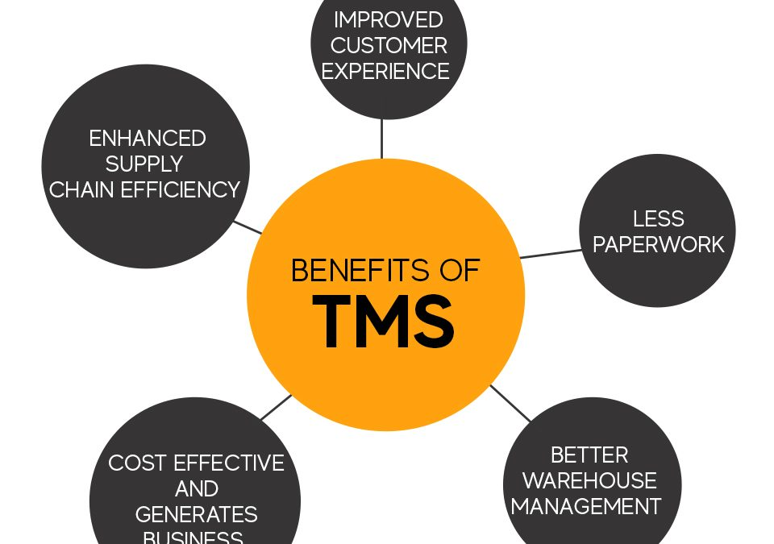

Slide 5
EXISTING SYSTEM
The present systems organize the entire information in file and ledgers.
It is difficult to search and retrieve relevant data, when required.
Its is difficult to view any particular information quickly. Lot of time is need to search the data.
PROPOSED SYSTEM
The proposed system is a web based application which maintains a centralized repository of all necessary information
This allows the users to access the information easily
The system allows to track and manage all information through well-defined interfaces.

Slide 6
Problem statement
Transport Management System (TMS) has design to manage the booking and maintenance of growing transport. Problem occurs when transports have mechanical problems are rented, vehicles that have been double booked and there have been cases when the wrong vehicle has been rented when it has been returned and not serviced. The current system has redundancy, where data cause by the manual system which uses paper to fill the information. Data is also not being kept in the secure location. Information lost is common by using manual system. The efficient planning and management of an organization's transport system is the key to providing a proficient transport network. Transport systems should ensure accessibility at an acceptable level of safety and comfort, in an environment-friendly manner for the movement of people. Additionally it encourages patterns of growth and economic activity by providing access to communities. Hopefully this system improves customer service and satisfaction.

Slide 7
Software requirements: Operating System - Windows Technology - Java and J2EE Web Technologies - Html, JavaScript, CSS Web Server - XAMPP Database - My SQLyog Java Version - J2SDK1.5
Hardware requirements:
Hardware - Pentium
Speed - 1.1 Ghz
RAM - 1GB
Hard Disk - 20 GB
Floppy Drive - 1.44 MB
Key Board - Standard Windows Keyboard
Mouse - Two or Three Button Mouse
Monitor - SVGA

Slide 8
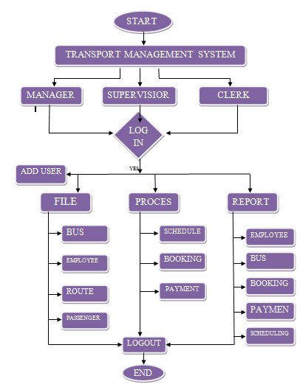
FLOW CHART

Slide 9
Scope & Objective For Project 1) To register and keep the information about all Buses. 2) To build up a system that provides and generates the summary 3) Report from the database records in order to get the whole view about the vehicles amounts. 4) Summarize the accidental records and responds for the further improvements. 5) A web based tool where user can search for additional information of the vehicle. 6) Adding more type of transport services.

Slide 10
ADVANTAGES
Reduced costs for the business and the and customer.
Improvement in visibility and security, especially in transit.
Simplification of supply chain processes.

Slide 11
Features
manager
View/Edit/Delete Vehicle Details
View/Edit/Delete Driver Details
Check booking Status Details
User Module
Login and Registration of user
Take a Bus Trip
View bus Details
bus Booking

Slide 12
Manager Module
In this the manager helps to client to arrange their trips.
He is allowed to change and upgrade vehicles.
Details of repaired vehicles, drivers, employees also available.
He is also allowed to add new routes, with new ticket price.

Slide 13
Booking clerk
In this module the clerk helps to keeps all record regarding buses every day collection.
Its check employees salary and performance
It is also calculate profit and loss.
The clients are directly contact with clerk for check the seats availability.

Slide 14
Supervisor
In the supervisor module, we get to know about different vehicles which have different mileage different seating arrangements.
Also in supervisor module, it shows the details of all the information regarding vehicles to both the guest and manager whereas giving extra privilege to the manager
In this supervisor track all trips from origin point to destination point.
It also take care of passengers and all vehicles.

Slide 15
Vehicles
Last is vehicles details in this module the details regarding the vehicle is presented.
The details are regarding:-
The driver details which are provided by the website.
The repair details of the car used by the guests.
Vehicles details module can only be accessed by the manager module.

Slide 16
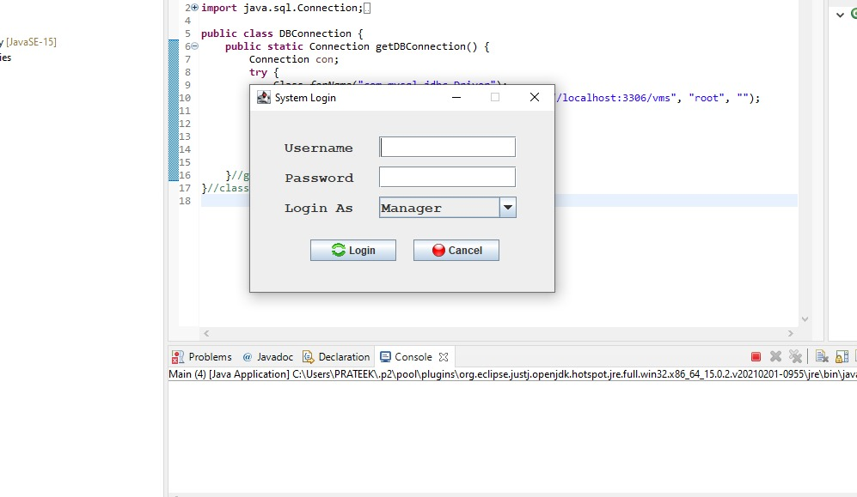
OUTPUT

Slide 17
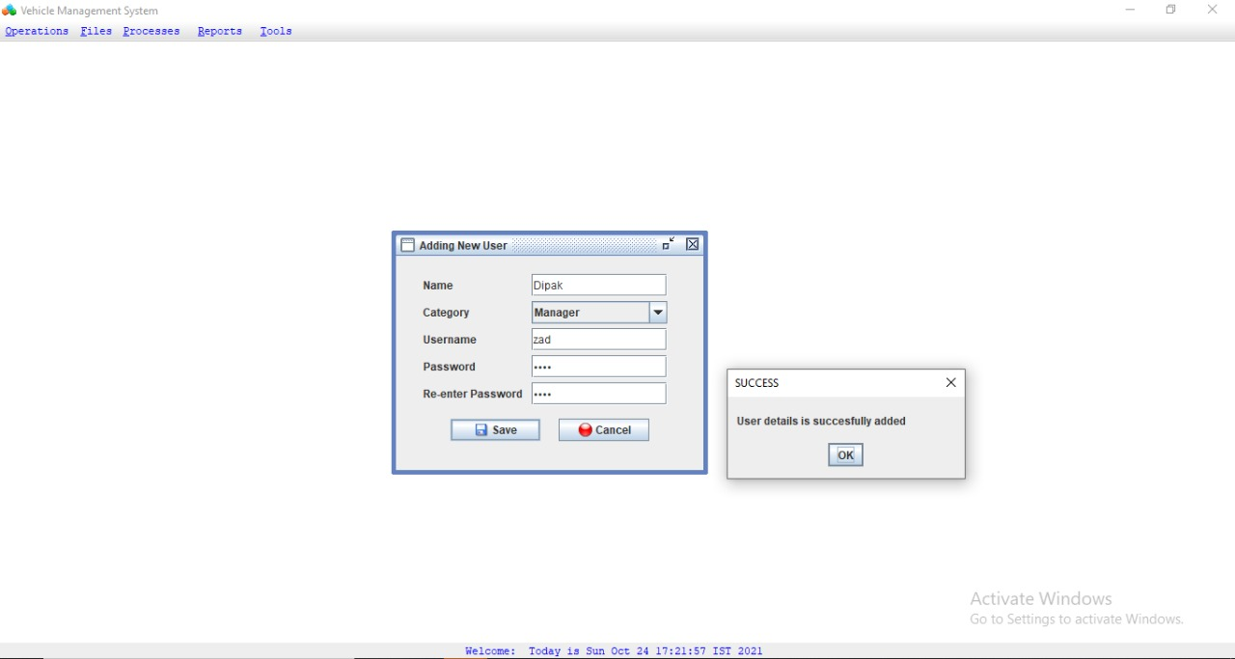
Sign UP Page

Slide 18
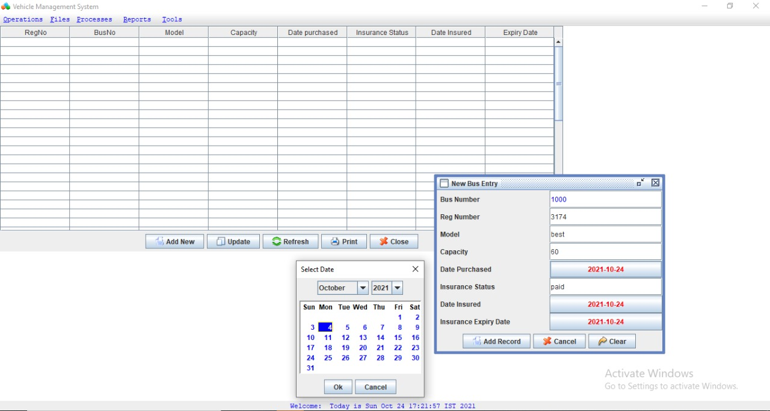
New Bus Entry

Slide 19
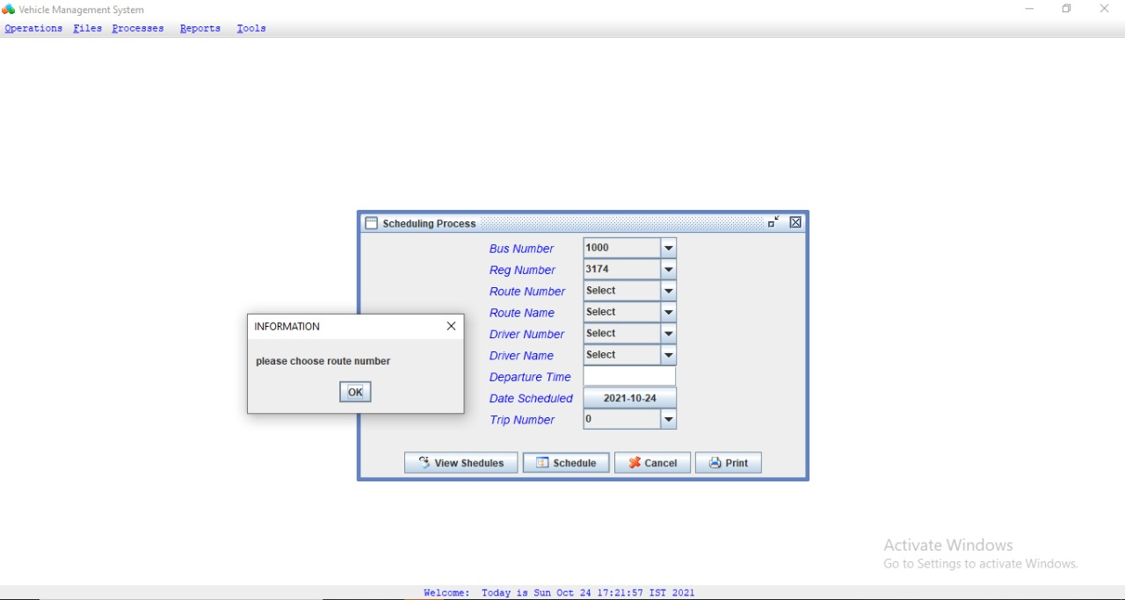
Trips Scheduling

Slide 20
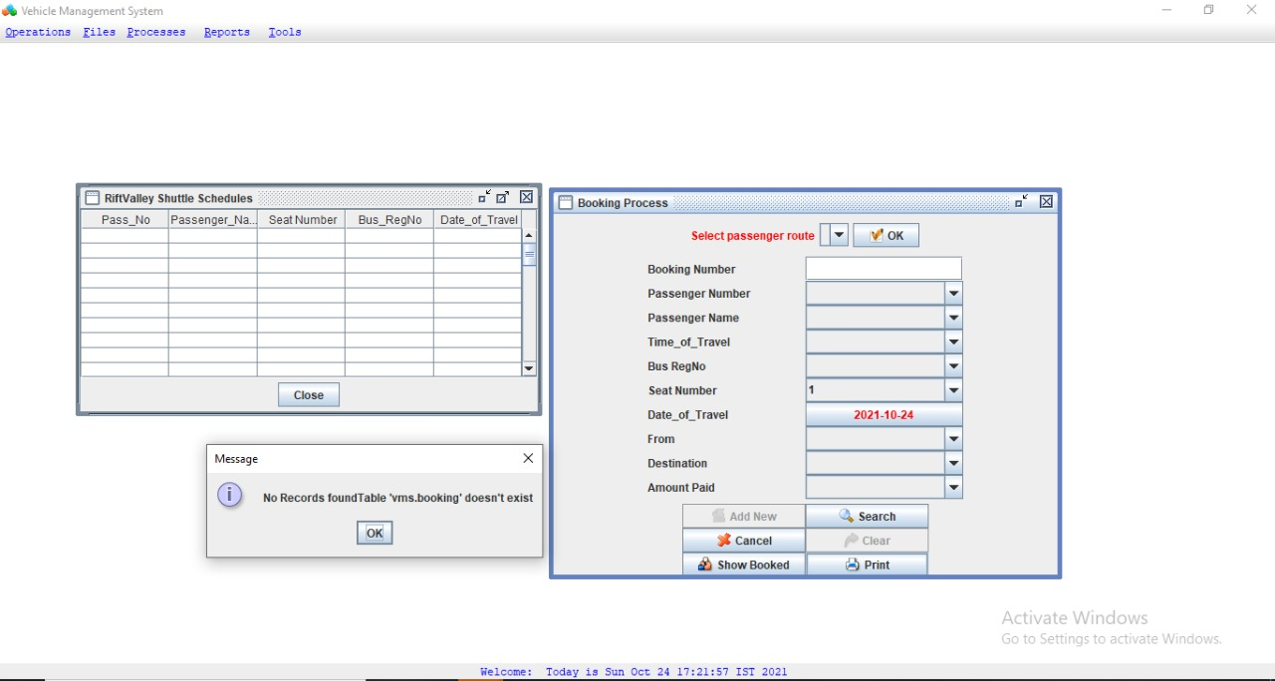
Tickets Booking System

Slide 21
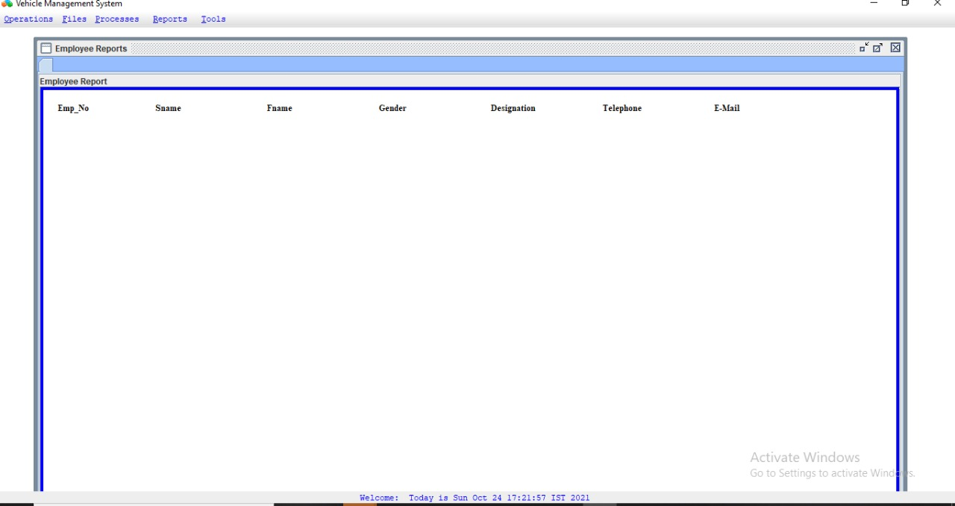
Records

Slide 22
CONCLUSION
The Transport Management System is an application that the manager launch the route ,add time and bus for the route and make updation for route,time and bus. After that the user give request for bus the manageristrator asign the bus for the user request.Then the user get information about bus.The user can give complaint about service and the manageristrator take action for the user complaint. The manageristrator get the user’s feedback.

Slide 23
REFERENCE
www.wikipedia.com
www.w3school.com www.google.com
www.youtube.com

Slide 24
THANK YOU

